Slide 1
Web 2.0 SIP Chatroom solution
Baptiste Bouffaut – June 2009

Slide 2
Introduction
This project implements a Web 2.0 to SIP gateway to access SIP services from any web browser:
  Chatrooms / Instant Messaging
  Presence
  Telephony
  Multimedia Content Sharing

Slide 3
Differentiators
Web chatroom based on SIP: it enables dialoging with any SIP device (softphone, IP phone…)
Include telephony services based on SIP: enables contacting any telephony device from any web browser
WEB SIP User-Agent: does not require any client software installation and maintenance

Slide 4
Technologies
Web 2.0 interface
AJAX application
SIP / HTTP servlets on top of Tomcat-mobicents application server (SIP API 1.1 – JSR 289)
Java Applet based on Java Media Framework (JMF) for media services (telephony, video)

Slide 5

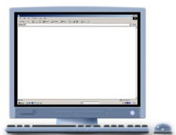

Architecture
Web Browser
Web 2.0 Chatroom SIP / HTTP servlet
XML / HTTP
Java Applet
RTP
JMF
MSRP (future)
Tomcat-Mobicents Application server
SIP / SIMPLE
SIP core (IMS / openser / asterisk…)
Components part of the Web 2.0 / SIP Chatroom solution
Components on the client PC
SIP / HTTP Servlets container
SIP Core components
SIP Registrar
SIP Proxy
Presence
server
PSTN
gateway

Slide 6
Features (1/3)
Strong User Authentication based on session key exchange:
  The solution keeps a mapping between the user connection characteristics (IP address, browser,…) and the session
  All XML / HTTP requests are signed with the session key so that they can be authentified by the servlet
Identities:
  A user can have several private identities (SIP softphone account, WEB account,…) associated to his public identity
  Public entity is set to “present” as soon as user is registered with at least one of his private identities (he can be connected with several)
Presence capabilities:
  Possibility to change manually update status
  Automatic presence update when user is on-call
  Impossibility to receive incoming call when in DND mode

Slide 7
Features (2/3)
Chatroom / Instant messaging capabilities:
  User can subscribe to several community chatrooms and access them via the same screen
  User can start private conversation with any buddy in the chatroom (except those in DND mode)
  Incoming messages are forked to all the private identities (SIP softphone, WEB account,…) the user is connected with
  Chatroom historic display
Telephony capabilities:
  Possibility to have direct audio call with one of the community member
  Possibility to receive incoming calls from any of the community member (except when in DND mode)
  Possibility to associate PSTN / PLMN numbers to the public entity
  Incoming calls are forked to all the private identities and associated numbers the user is connected with

Slide 8
Features (3/3)
Multi-media Content Sharing capabilities:
  Push mode (development on-going): enables each community member to upload mulitmedia content (photos, audio, videos, document…) on the chatroom so that all members of the chatroom can access it (blog mode)
  Peer-to-peer mode (future development): based on RCS recommendations, use MSRP to transfer multi-media files from peer to peer.

Slide 9
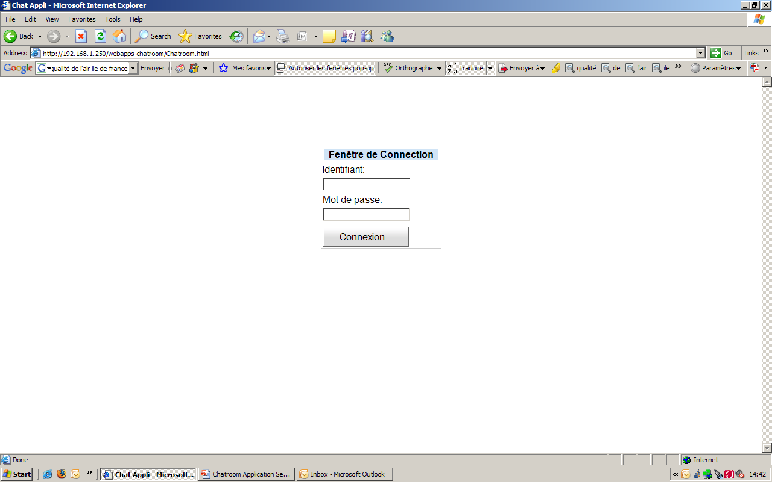
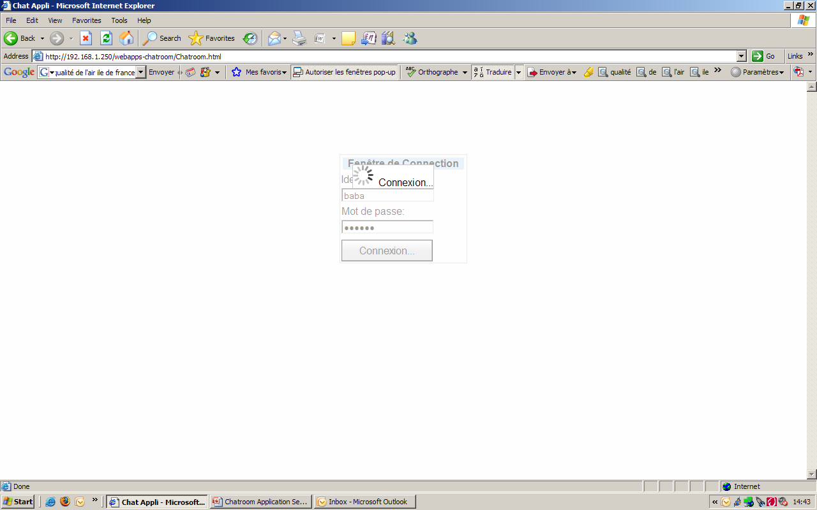
Use-Cases
WEB authentication

Slide 10
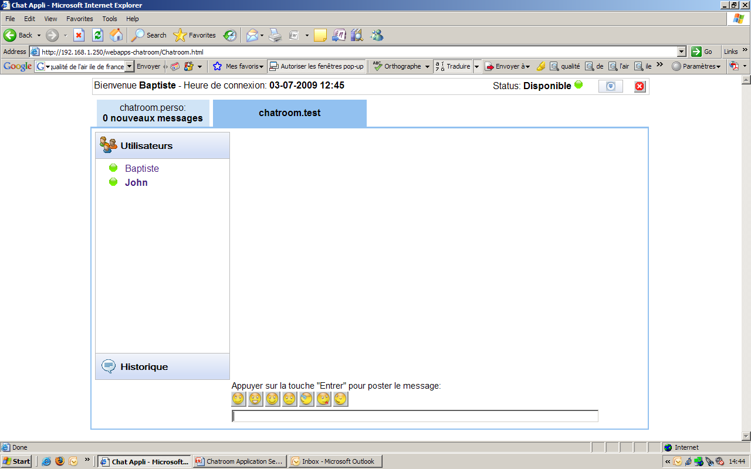
Use-Cases
Home page

Slide 11
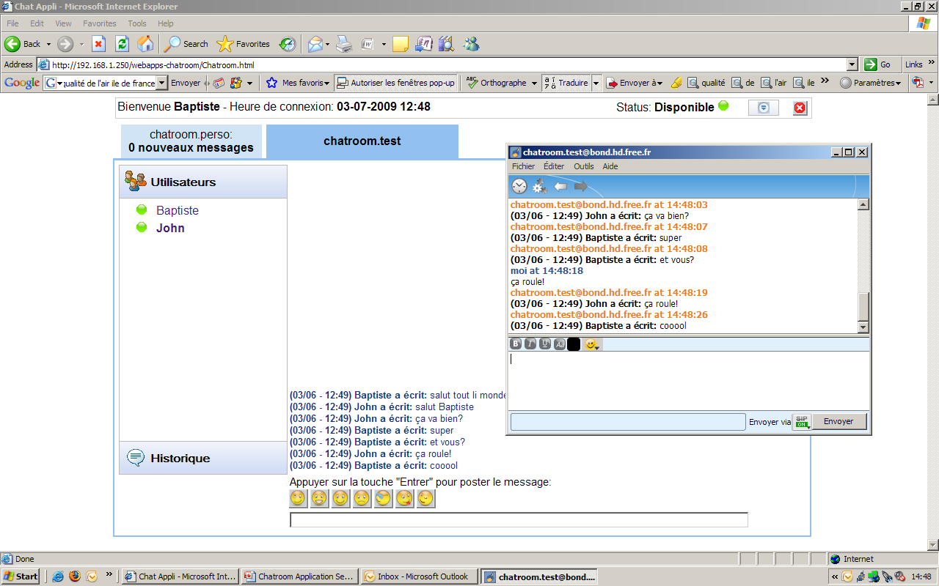
Use-Cases
Chat in the chatroom: Baptiste is connected on his WEB account and John via his SIP softphone. Exchange of messages on the chatroom.

Slide 12
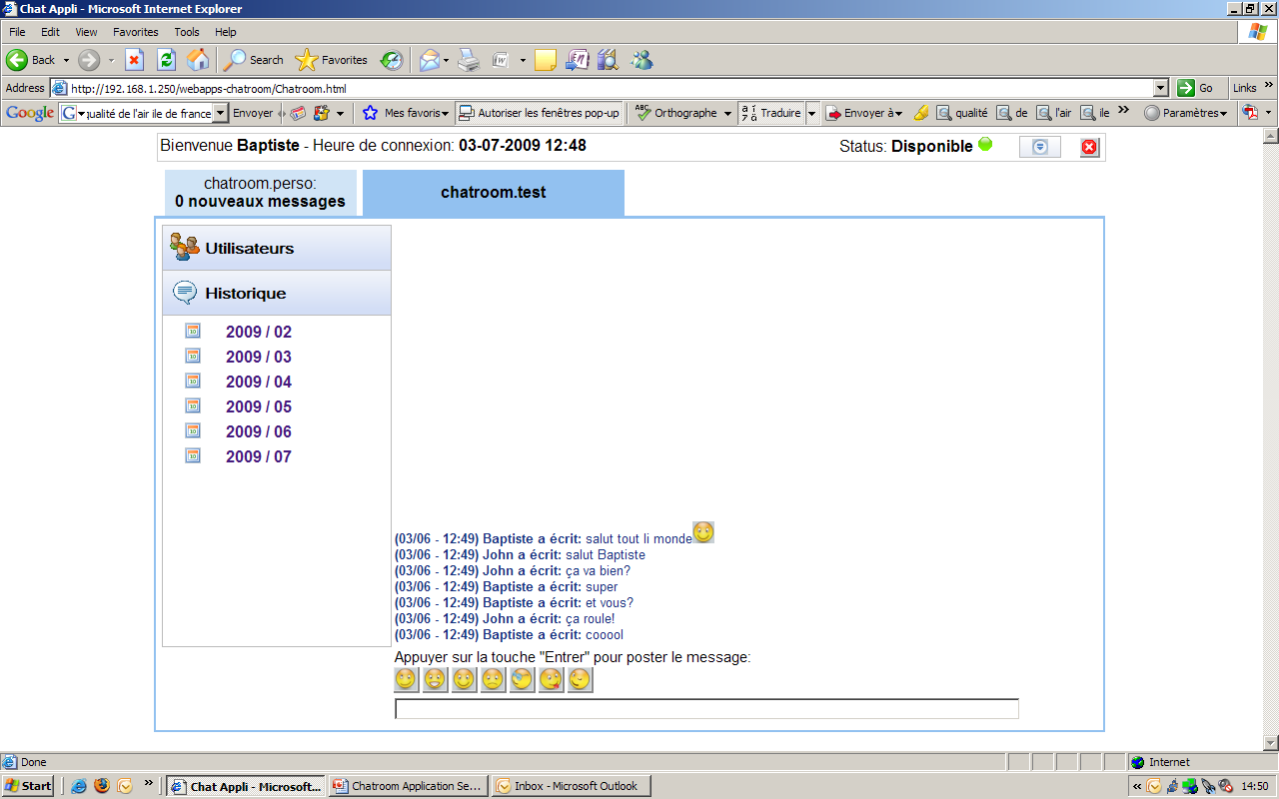
Use-Cases
Historic of the chatroom (1 / 2)

Slide 13
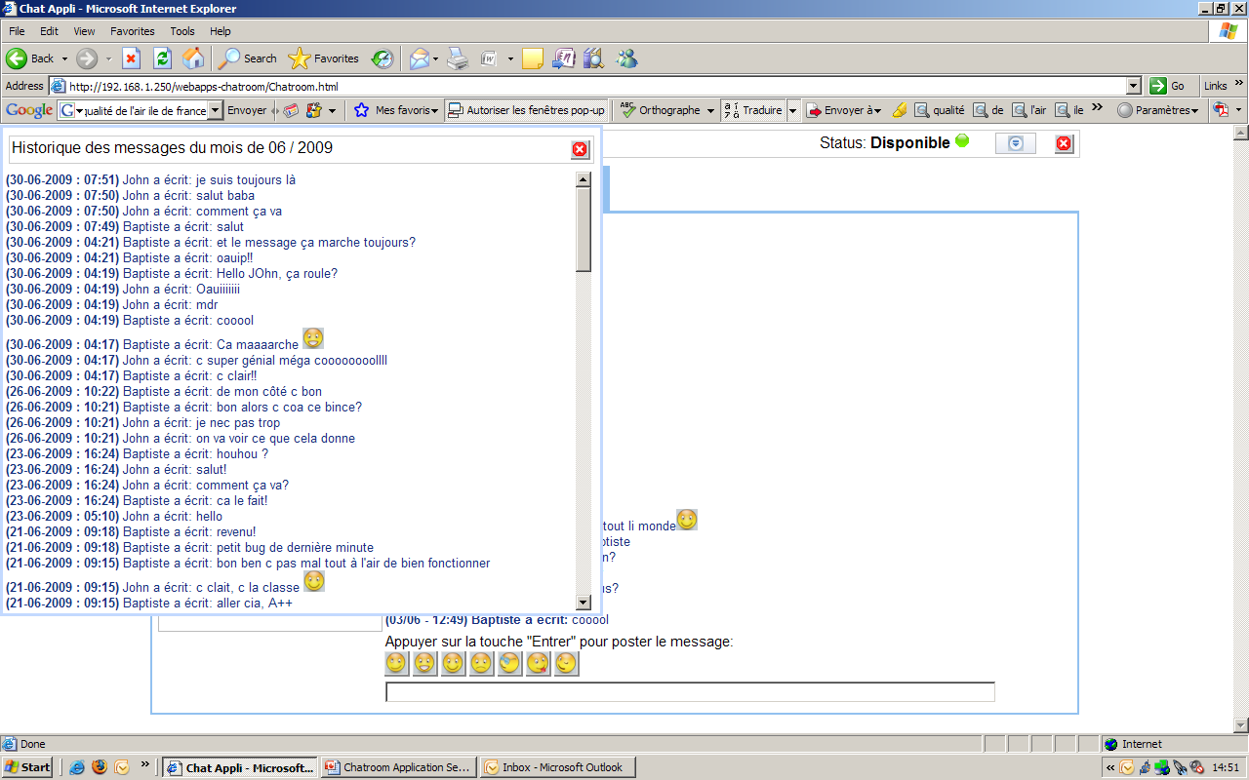
Use-Cases
Historic of the chatroom (2 / 2)

Slide 14
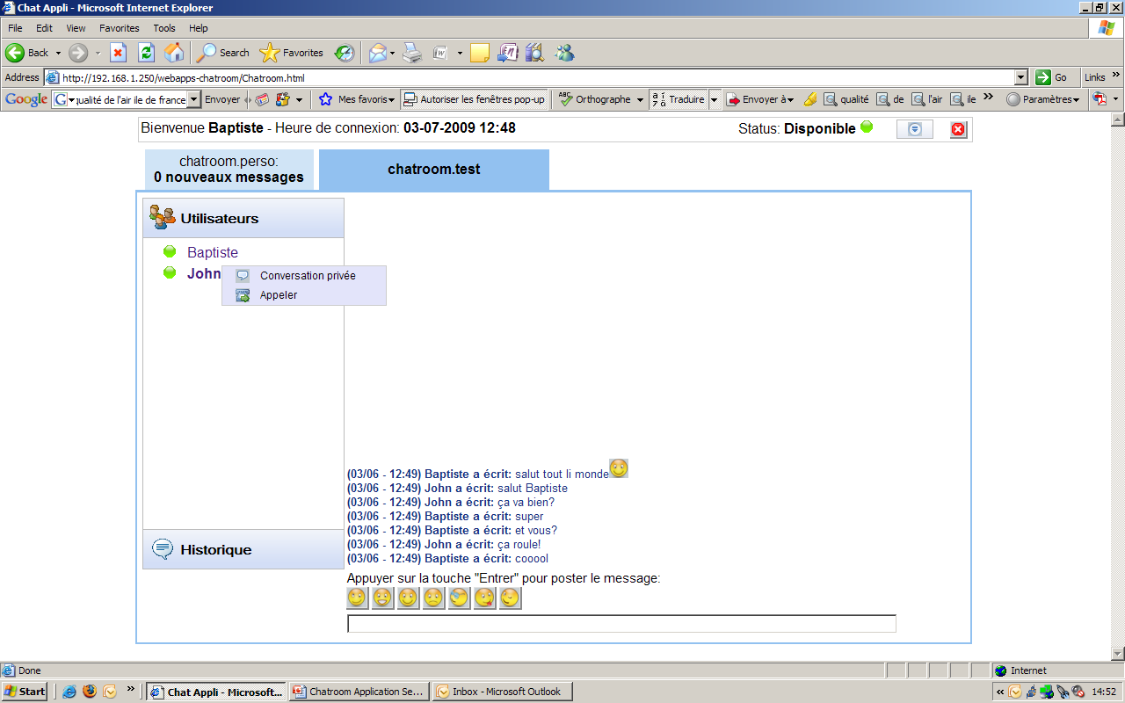
Use-Cases
Buddy menu

Slide 15
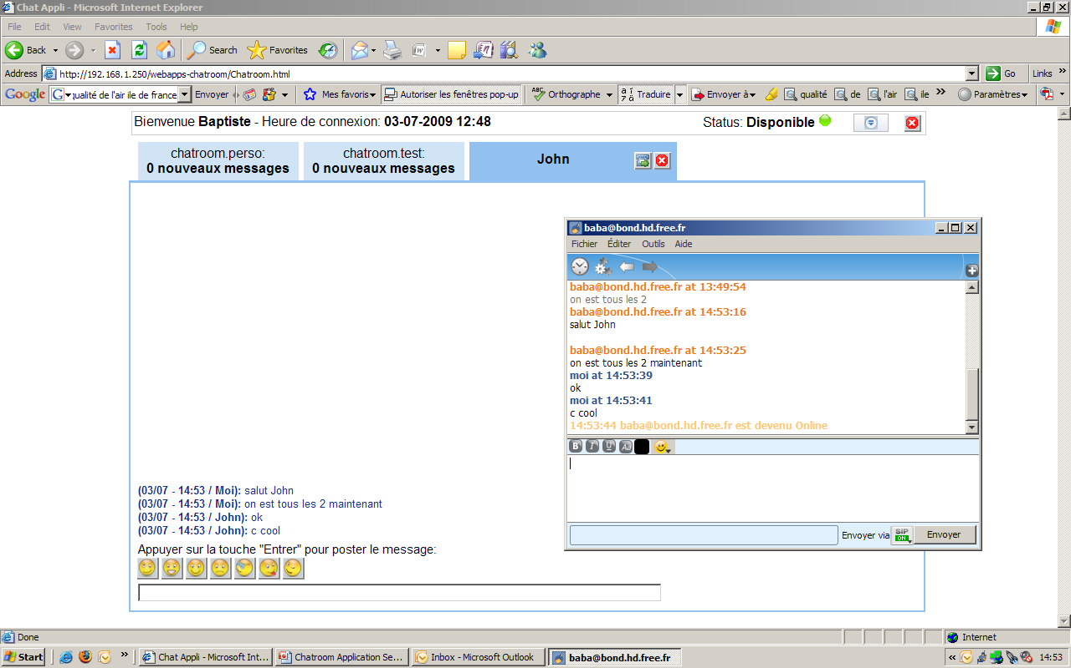
Use-Cases
Private chat: Baptiste is connected on his WEB account and John via his SIP softphone

Slide 16
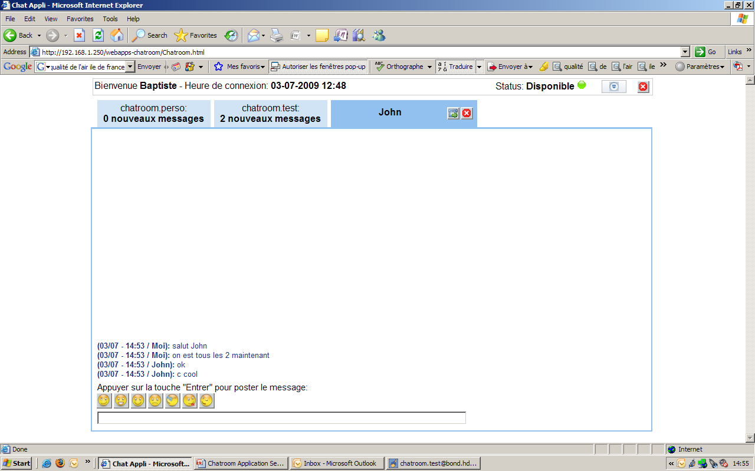
Use-Cases
Private chat: Numbers of new messages are displayed in the top-bar menu for each chatrooms

Slide 17
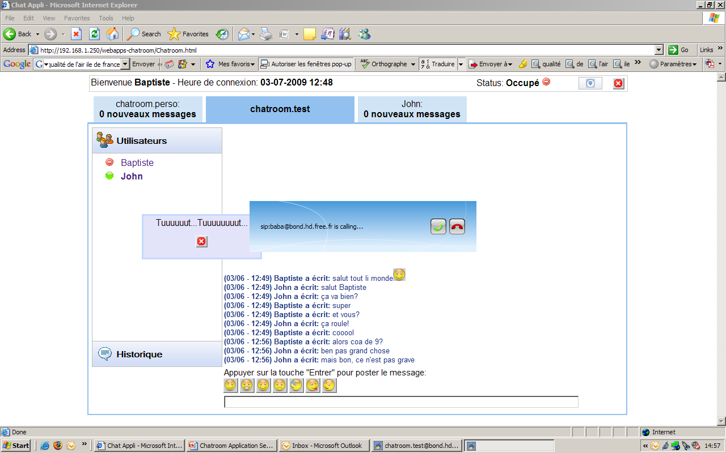
Use-Cases
Make a call: Baptiste is connected on his WEB account and John via his SIP softphone. Baptiste calls John via the buddy menu. John softphone is ringing

Slide 18
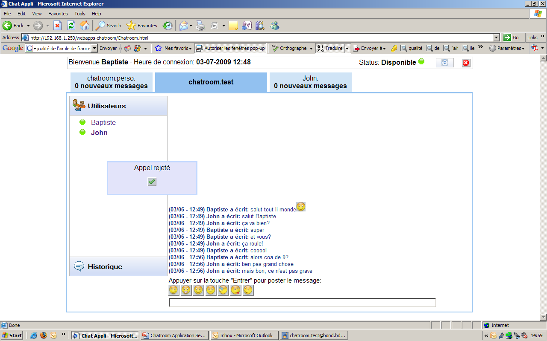
Use-Cases
Make a call: Baptiste is connected on his WEB account and John via his SIP softphone. Baptiste calls John via the buddy menu. John rejects the call.

Slide 19
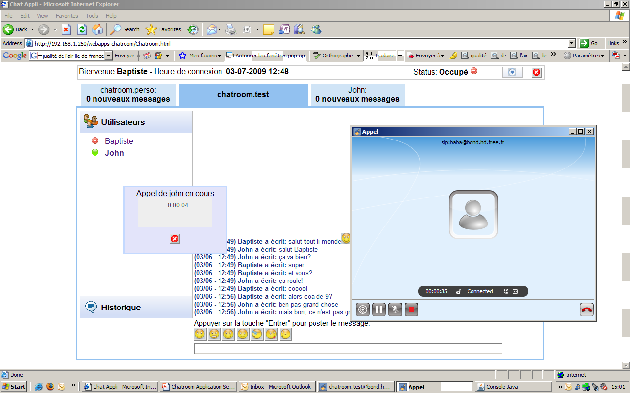
Use-Cases
Make a call: Baptiste is connected on his WEB account and John via his SIP softphone. Baptiste calls John via the buddy menu. John accepts the call on his softphone. Telephony Applet is launched on Baptiste WEB page.

Slide 20
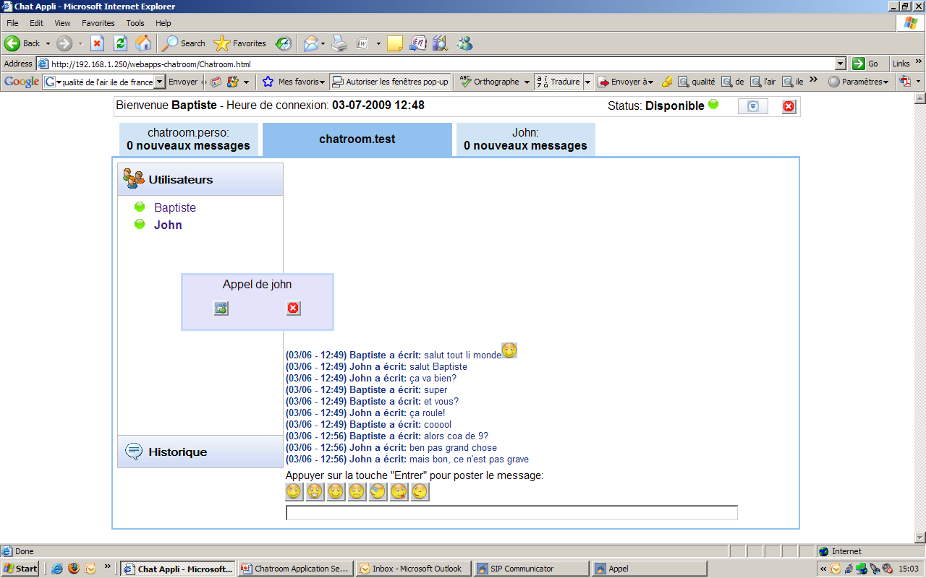
Use-Cases
Incoming call: Baptiste is connected on his WEB account and John via his SIP softphone. John calls Baptiste. Incoming call popup raises on Baptiste WEB page. Baptiste can accept or reject the call. If accepted, Telephony applet is launched.

Slide 21
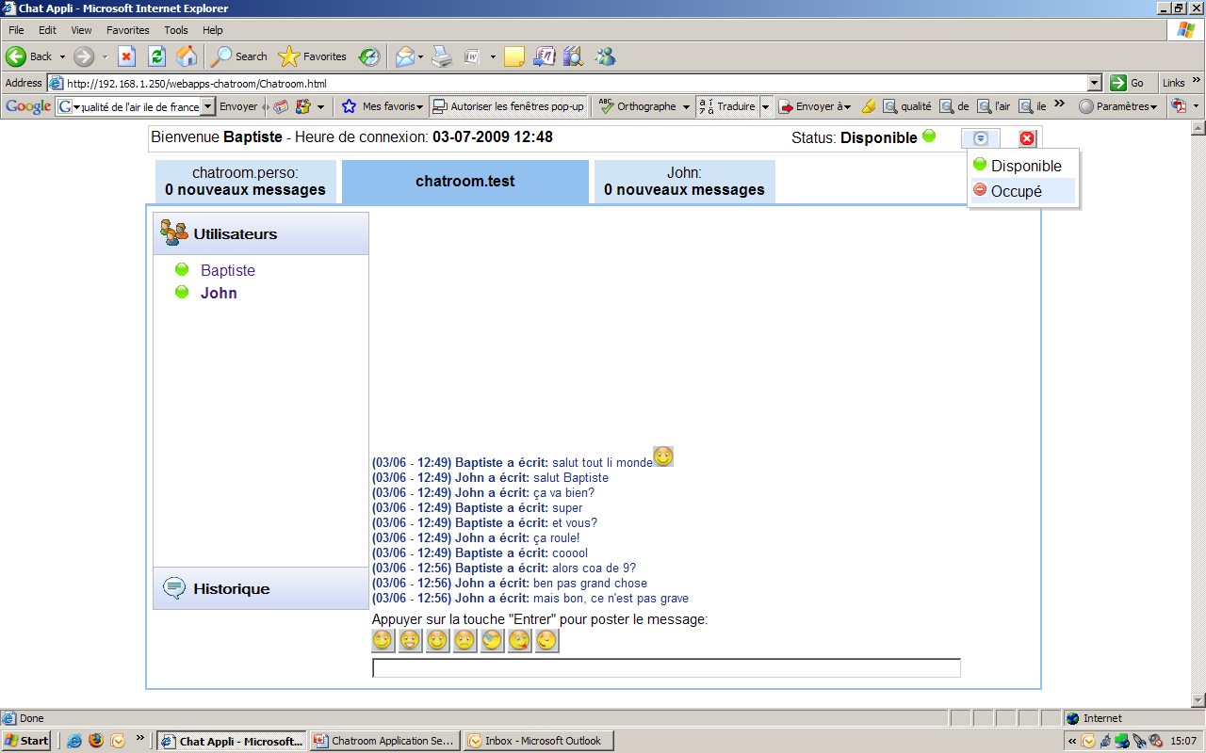
Use-Cases
Presence status update: Baptiste is connected on his WEB account. He modifies his presence status in the tool-bar menu.

